Slide 1

SHINE – (Advanced) faSHion engINE
Cellini Lorenzo
Corso in Multimedia Data Management​ - Prof. Ilaria Bartolini​
Laurea magistrale in artificial intelligence A.A. 2021/22​

Slide 2
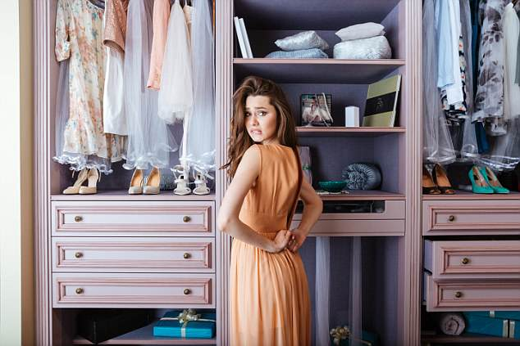
Any time I look at my girlfriend opening the wardrobe and spending a lot of time choosing how to dress up, I think how useful could be an automatic and intelligent fashion personal assistant…

Slide 3
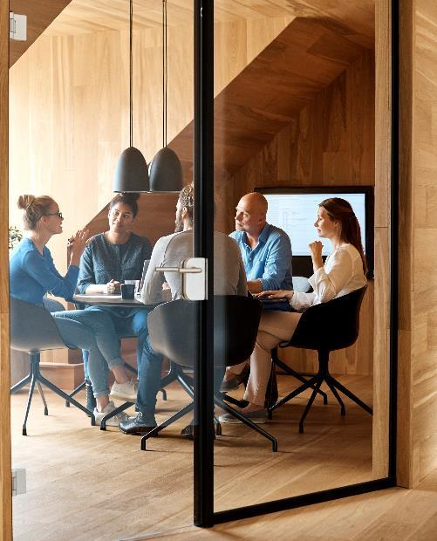



Description
SHINE is an intelligent fashion engine, based on multimedia data management, that helps you choosing the right outfit based on your search criteria. It can also learn your fashion preferences and save you a lot of time before a date, by recommending the best combination from your wardrobe clothes or simply giving you advices.

Slide 4
Exercise 1.A
Structured data
Semi-structured data
Unstructured data
Clothes DB with attributes like ID, type, brand, collection year, color, size, season, materials, owned, price, URL…
User accounts DB
Object taxonomy
Geographical taxonomy (used for exploit differences in country’s fashion)
Sector taxonomy (eg. Sport, party, work)
Style
Pictures of clothes (like in e-commerce catalogues)
Pictures from socials (e.g. fashion influencers or famous people)
Text from reviews and fashion blogs
Text from clothes description

Slide 5
Structured data – Clothes DB
ID | Type | Brand | Collection year | Color | Size | Material | Owned | Price (€) | URL
0001 | shirt | Gucci | 2021 | [Red,Green] | M | Cachemire | 1 | 770 | https://storage....
0002 | coat | Prada | 2022 | [Red] | XL | Velvet | 0 | 800 | https://storage....

Slide 6
Structured data– Users DB
ID | User | First name | Last name | Age | Country | Device | Subscription
0001 | Mrossi | Maria | Rossi | 35 | Italy | Smartphone | Premium
0002 | JDO92 | Jhon | Doe | 27 | Ireland | PC | Free

Slide 7
Semi-Structured data – Object taxonomy* (1)
Object
Woman
Man
Maternity
Dress
Sportswear separates
Evening and bridal
Outerwear
Suits
Active wear
Swimwear - beachwear
1-piece
2-piece
…
Top
Bottom
…
Cocktail
Wedding
…
Coats
Raincoats
…
Jacket
Pants
Skirts
…
Dancewear
Jogging suits
…
Intimate apparel
Miscellaneous
Footwear
Accessories
Lingerie
Loungewear
…
Uniform
Aprons
…
Heels
Boots
…
Scarves
Hats
Jewelry
…
* levels in bullet points could be further expanded

Slide 8
Semi-Sstructured data – Object taxonomy (2)
Object
Woman
Man
Work clothing
Intimate apparel
Sportswear
Evening and bridal
Outerwear
Tailored
Active wear
Swimwear - beachwear
Underwear
Sleepwear
…
Top
Bottom
…
Cocktail
Wedding
…
Parkas
Ski pants
…
Suits
Shirt
…
Shorts
Sport shirts
…
Brief
Trunk
…
Miscellaneous
Footwear
Accessories
Uniform
Aprons
…
Slip-on
Lace-up
…
Scarves
Hats
Jewelry
…
* levels in bullet points could be further trated as taxonomy nodes

Slide 9
Semi-Structured data – Sector taxonomy
Sector
Sport
Spare time
[ … ]
Beach
Party
Mountain
City

Slide 10
Semi-Structured data – Sport taxonomy
Sport
Indoor
Outdoor
Combat
Invasion
Racing
Target
Ind. aesthetic
Fielding
Ind. aiming
[ … ]
Boxing
Kung-Fu
MMA
…
Volleyball
Basketball
Waterpolo
…
Swimming
Ice skating
Archery
Curling
…
Figure skating
Diving
…
Volleyball
Basketball
Waterpolo
…
Golf
…

Slide 11
Semi-Structured data – Geography taxonomy
Region
Africa
Asia
Australia
Europe
America
[ … ]
[ … ]
[ … ]
[ … ]
North America
Central America
South America
US
Canada
Mexico
[ … ]
[ … ]
California
Oregon
Utah
…

Slide 12
Semi-Structured data – Style taxonomy
Any
Business
Casual
Extravagant
Modern
Vintage
Ethnic
Casual
Formal
…
Dressy
Festive attire
…
Dandy
Bohemian
…
Rock
Punk
Hippie
…
Afro
Japanese
Mexican
…
20’s
50’s
60’s
70’s
80’s
90’s

Slide 13
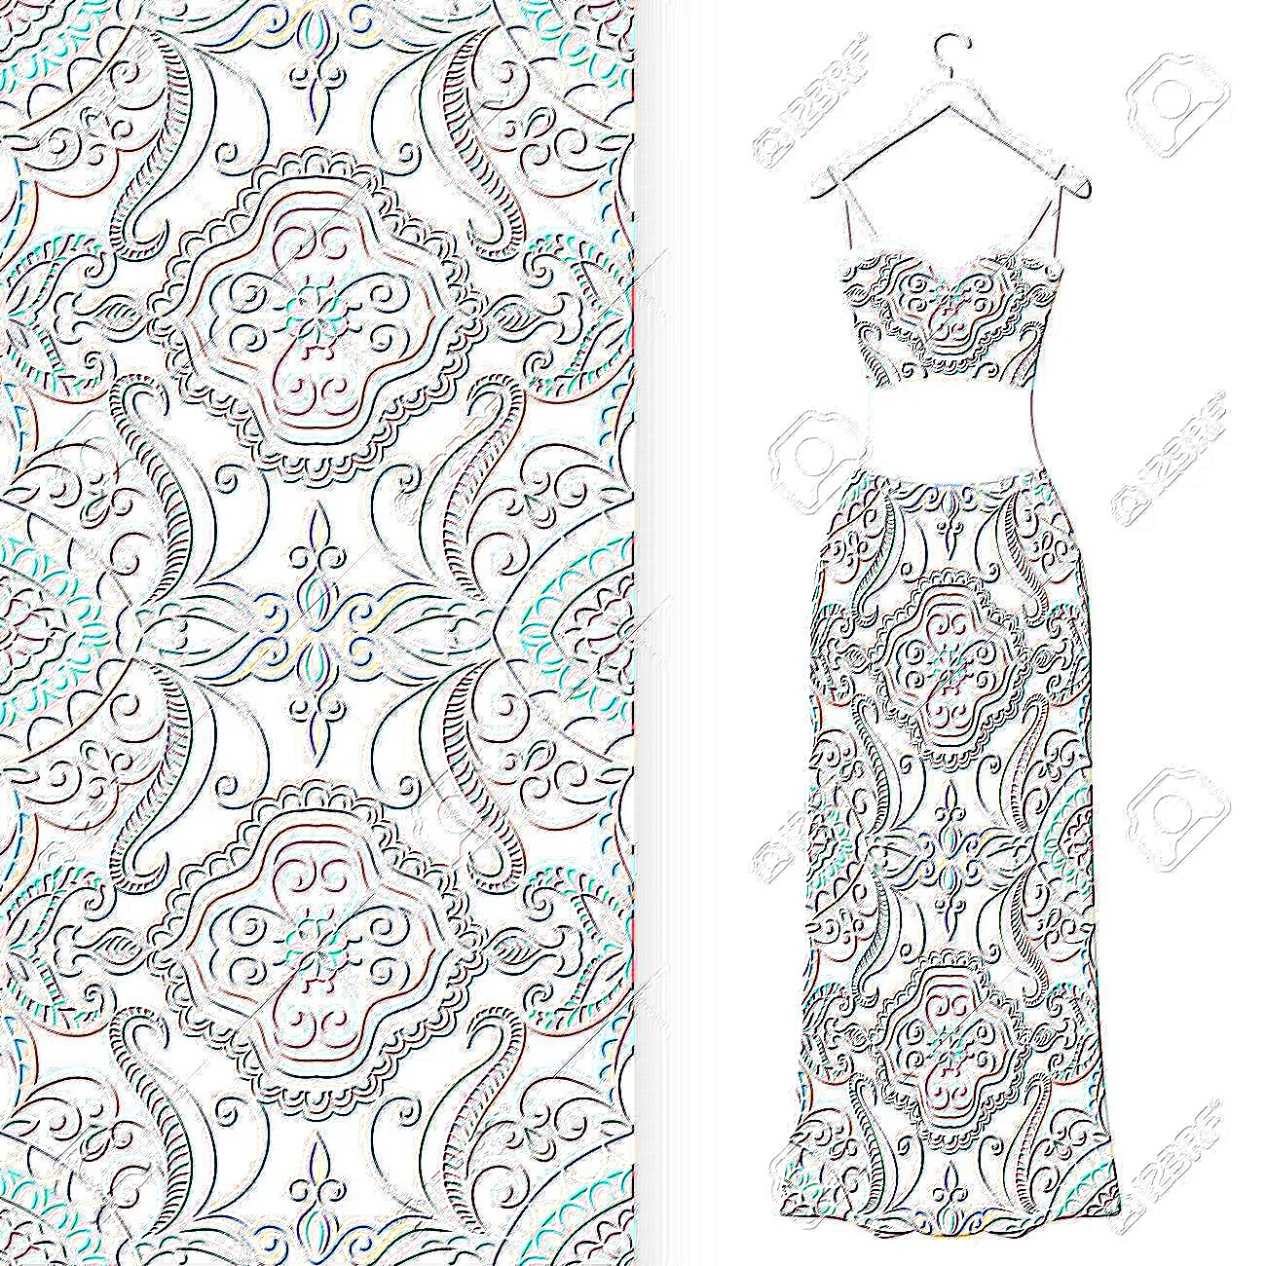
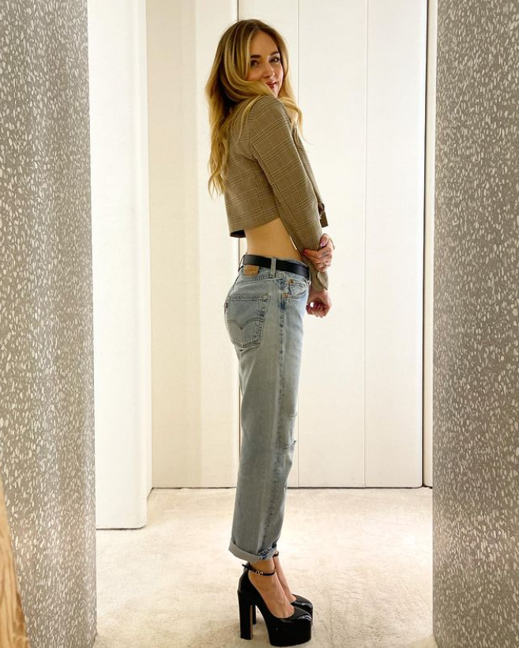
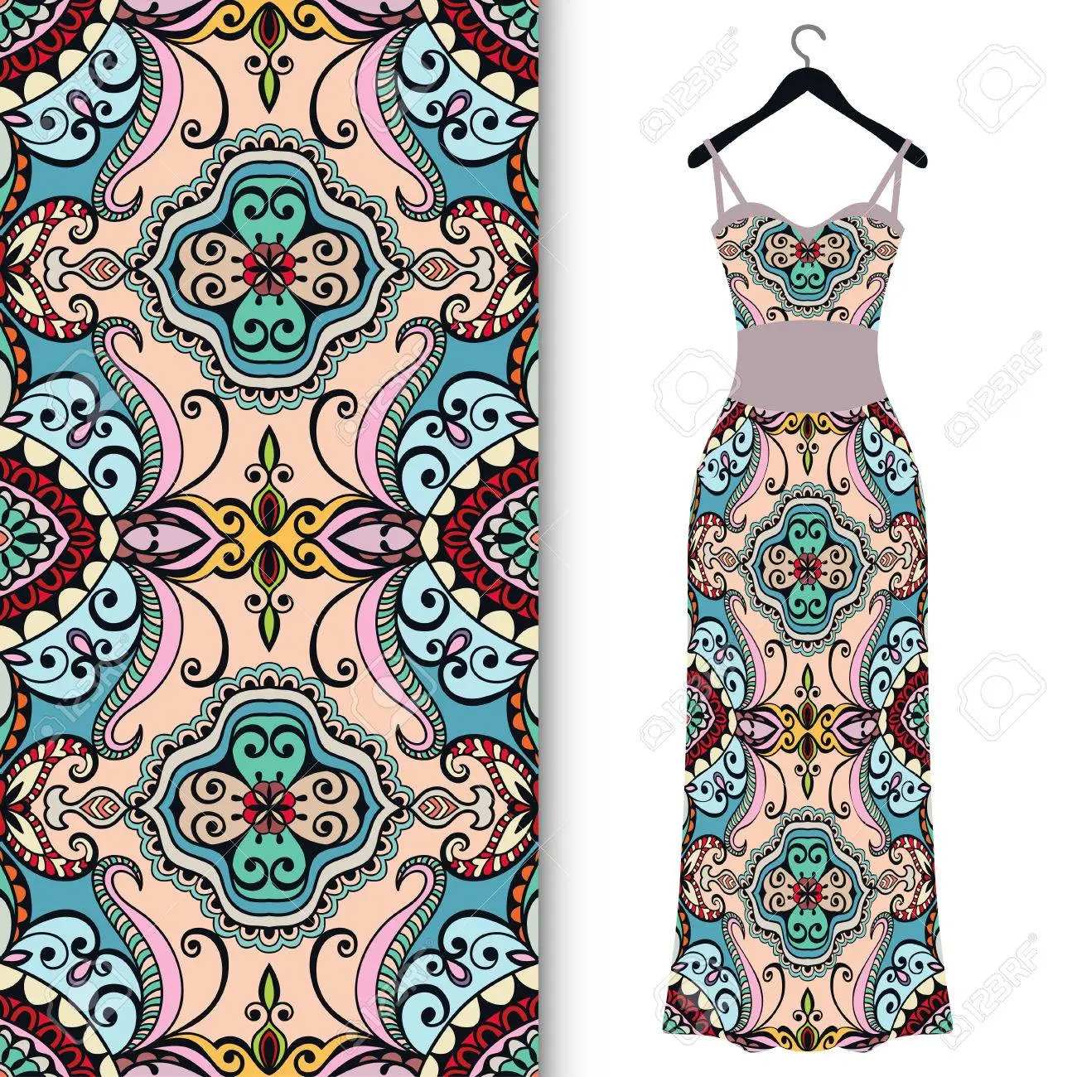
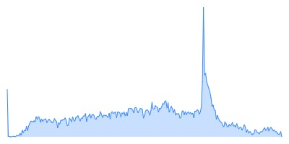
Unstructured data – Low level features
HSV Color distribution
Texture
Shape detection (after segmentation + clothes recognition)
Regions similarity
Key-points matching
At runtime the user can ask either for an outfit proposal (browsing based on tags), or ask for outfit matching by providing a picture of a cloth as starting point (QBE).

Slide 14
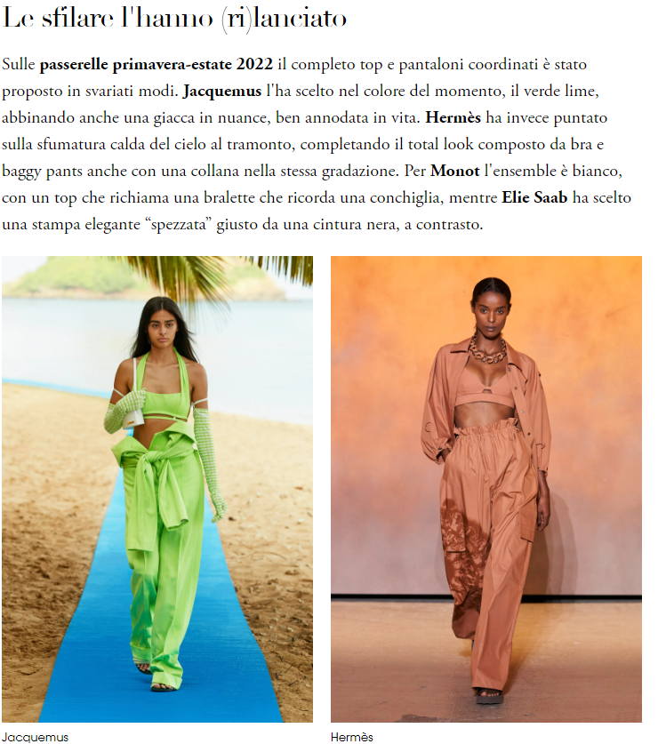
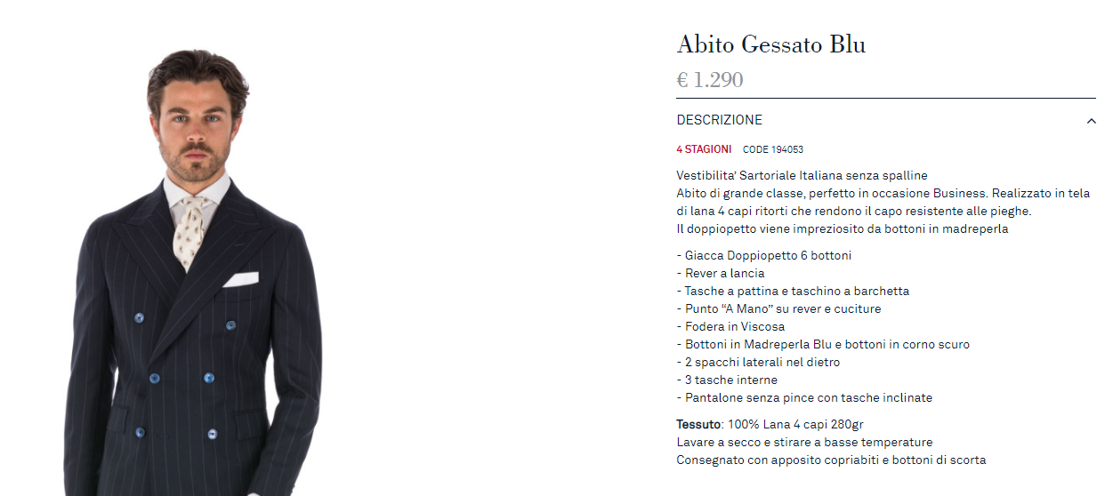
Unstructured data – Text
MMG + RWR + MWQP (à la IMAGINATION) and NLP techniques, such as word embedding + transformers for text comprehension, in order to automatically detect outfits (clothes combinations)
Term-document matrix for cloth description

Slide 15
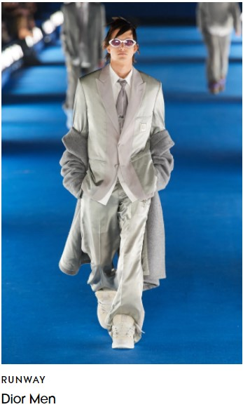
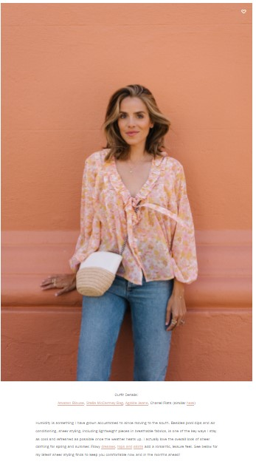
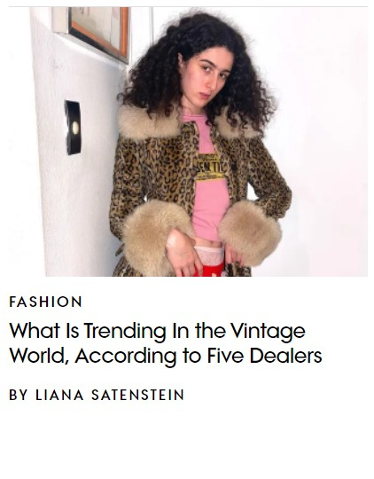
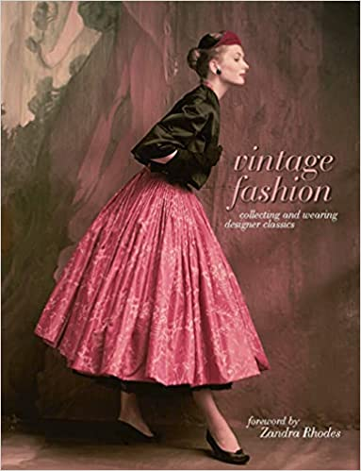
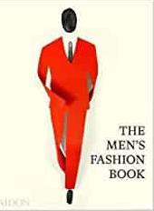
Exercise 1.C – Information Retrieval
Doc_1:
Doc_2:
Doc_3:
Doc_4:
Doc_5:
Vogue article on vintage fashion
Vogue article on men’s fashion
Fashion influencer blog post
Book Vintage Fashion: Collecting and wearing designer classics
The Men’s Fashion Book

Slide 16
Boolean Model: Term-Document Matrix
Apply stop-words removal and lemmatization. Then reduce documents to BoWs vectors, based on extracted keywords. In this context complex index terms (e.g. lace-up) are also needed.
At this stage, only boolean queries are allowed:
Term | Doc_1 | Doc_2 | Doc_3 | Doc_4 | Doc_5
Vintage | 1 | 0 | 0 | 1 | 0
Man | 0 | 1 | 0 | 1 | 1
Woman | 1 | 0 | 1 | 1 | 0
Green | 1 | 0 | 1 | 1 | 1
White | 1 | 1 | 1 | 1 | 1
Shirt | 1 | 1 | 1 | 1 | 1
Dress | 0 | 0 | 1 | 1 | 0
Skirt | 1 | 0 | 0 | 1 | 0
Tie | 0 | 1 | 0 | 1 | 1
Summer | 1 | 1 | 0 | 1 | 1
2022 | 0 | 1 | 1 | 0 | 0
Winter | 0 | 0 | 1 | 1 | 1
Dress AND Winter AND NOT Vintage
Woman AND Summer AND (Dress OR Skirt)

Slide 17
Boolean Model: Term-Document Matrix
Dress AND Winter AND NOT Vintage
Term | Doc_1 | Doc_2 | Doc_3 | Doc_4 | Doc_5
Vintage | 1 | 0 | 0 | 1 | 0
Man | 0 | 1 | 0 | 1 | 1
Woman | 1 | 0 | 1 | 1 | 0
Green | 1 | 0 | 1 | 1 | 1
White | 1 | 1 | 1 | 1 | 1
Shirt | 1 | 1 | 1 | 1 | 1
Dress | 0 | 0 | 1 | 1 | 0
Skirt | 1 | 0 | 0 | 1 | 0
Tie | 0 | 1 | 0 | 1 | 1
Summer | 1 | 1 | 0 | 1 | 1
2022 | 0 | 1 | 1 | 0 | 0
Winter | 0 | 0 | 1 | 1 | 1
Dress: 00110 AND
Winter: 00111 AND
NOT Vintage: 01101
Result: 00100

Slide 18
Boolean Model: Term-Document Matrix
Woman AND Summer AND (Dress OR Skirt)
Term | Doc_1 | Doc_2 | Doc_3 | Doc_4 | Doc_5
Vintage | 1 | 0 | 0 | 1 | 0
Man | 0 | 1 | 0 | 1 | 1
Woman | 1 | 0 | 1 | 1 | 0
Green | 1 | 0 | 1 | 1 | 1
White | 1 | 1 | 1 | 1 | 1
Shirt | 1 | 1 | 1 | 1 | 1
Dress | 0 | 0 | 1 | 1 | 0
Skirt | 1 | 0 | 0 | 1 | 0
Tie | 0 | 1 | 0 | 1 | 1
Summer | 1 | 1 | 0 | 1 | 1
2022 | 0 | 1 | 1 | 0 | 0
Winter | 0 | 0 | 1 | 1 | 1
Woman: 10110 AND
Summer: 11011 AND
(Dress: 00110 OR
Skirt: 10010 )
Result: 10010

Slide 19
Information Retrieval: Inverted Index
Term | N docs | Tot Freq
2022 | 2 | 5
Dress | 2 | 57
Green | 4 | 99
Man | 3 | 101
Shirt | 5 | 375
Skirt | 2 | 316
Summer | 4 | 112
Tie | 3 | 236
Vintage | 2 | 88
White | 5 | 569
Winter | 3 | 164
Woman | 3 | 231
Apply stemming before computing the inverted index, in order to have more robust results
Sort terms and merge frequency counts
Add positional information in order to better handle outfits as combination of (close in text) clothes of compound words such as «lace-up»
Doc # | Freq
… | …
Doc_1 | 27: 33, 45, …
Doc_2 | 10: 5,17, …
Doc_3 | 23: 12, 19, …
Doc_4 | 128: 44, 69, …
Doc_5 | 187: 35, 40, …
… | …

Slide 20
Information Retrieval: Inverted Index – Query 1
Dress AND Winter AND NOT Vintage
Logical operations addressed as set operations
Doc # | Freq
Doc_3 | 30: …
Doc_4 | 27: …
Doc_3
Term | N docs | Tot Freq
2022 | 2 | 5
Dress | 2 | 57
Green | 4 | 99
Man | 3 | 101
Shirt | 5 | 375
Skirt | 2 | 316
Summer | 4 | 112
Tie | 3 | 236
Vintage | 2 | 88
White | 5 | 569
Winter | 3 | 164
Woman | 3 | 231
AND
Doc # | Freq
Doc_1 | 10: …
Doc_4 | 78: …
NOT
Doc # | Freq
Doc_3 | 15: …
Doc_4 | 100: …
Doc_5 | 49: …

Slide 21
Information Retrieval: Inverted Index – Query 2
Doc # | Freq
Doc_3 | 30: …
Doc_4 | 27: …
Woman AND Summer AND (Dress OR Skirt)
Logical operations addressed as set operations
Doc # | Freq
Doc_1 | 30: …
Doc_3 | 30: …
Doc_4 | 286: …
Term | N docs | Tot Freq
2022 | 2 | 5
Dress | 2 | 57
Green | 4 | 99
Man | 3 | 101
Shirt | 5 | 375
Skirt | 2 | 316
Summer | 4 | 112
Tie | 3 | 236
Vintage | 2 | 88
White | 5 | 569
Winter | 3 | 164
Woman | 3 | 231
OR
Doc_1
Doc # | Freq
Doc_1 | 30: …
Doc_4 | 286: …
AND
Doc_4
Doc # | Freq
Doc_1 | 22: …
Doc_2 | 4: …
Doc_4 | 50: …
Doc_5 | 36: …
Doc # | Freq
Doc_1 | 11: …
Doc_3 | 50: …
Doc_4 | 170: …

Slide 22
IR – Vector Space Model
In the VSM documents are represented by vectors d in R^{T} (in this case T=12)
For each document j, d_{i}=w_{i,j}
Interpreting the query as a vector too, in order to retrieve and rank the documents it is sufficient to compute their similarities w.r.t. the query vector q
Let’s compute tf_idf metric for each term-document and then normalize it in order to compute similarities in an easier way
Term | Doc_1 | Doc_2 | Doc_3 | Doc_4 | Doc_5
2022 | 0 | 0,282661 | 0,094633 | 0 | 0
Dress | 0 | 0 | 0,709744 | 0,084437 | 0
Green | 0,052133 | 0 | 0,115229 | 0,03808 | 0,049354
Man | 0 | 0,472745 | 0 | 0,048817 | 0,359487
Shirt | 0 | 0 | 0 | 0 | 0
Skirt | 0,917463 | 0 | 0 | 0,89441 | 0
Summer | 0,163848 | 0,275345 | 0 | 0,03808 | 0,080761
Tie | 0 | 0,787908 | 0 | 0,099377 | 0,893582
Vintage | 0,305821 | 0 | 0 | 0,24393 | 0
White | 0 | 0 | 0 | 0 | 0
Winter | 0 | 0 | 0,197839 | 0,174345 | 0,251641
Woman | 0,187542 | 0 | 0,659462 | 0,296387 | 0

Slide 23
Vector Space Model – Query 1
Dress AND Winter AND NOT Vintage
Doc # | W_{i,j}
Doc_3 | 0,709744
Doc_4 | 0,084437
Term | N docs | Tot Freq
2022 | 2 | 5
Dress | 2 | 57
Green | 4 | 99
Man | 3 | 101
Shirt | 5 | 375
Skirt | 2 | 316
Summer | 4 | 112
Tie | 3 | 236
Vintage | 2 | 88
White | 5 | 569
Winter | 3 | 164
Woman | 3 | 231
Doc # | W_{i,j}
Doc_3 | 0,907583
Doc_5 | 0,251641
AND
Doc # | W_{i,j}
Doc_1 | 0,305821
Doc_4 | 0,24393
NOT
Doc_3
Doc # | W_{i,j}
Doc_3 | 0,197839
Doc_4 | 0,174345
Doc_5 | 0,251641

Slide 24
Vector Space Model – Query 2
Doc # | W_{i,j}
Doc_3 | 0,709744
Doc_4 | 0,084437
Woman AND Summer AND (Dress OR Skirt)
Doc # | W_{i,j}
Doc_1 | 0,917463
Doc_3 | 0,709744
Doc_4 | 0,978847
Term | N docs | Tot Freq
2022 | 2 | 5
Dress | 2 | 57
Green | 4 | 99
Man | 3 | 101
Shirt | 5 | 375
Skirt | 2 | 316
Summer | 4 | 112
Tie | 3 | 236
Vintage | 2 | 88
White | 5 | 569
Winter | 3 | 164
Woman | 3 | 231
OR
Doc # | W_{i,j}
Doc_1 | 0,917463
Doc_4 | 0,89441
Doc # | W_{i,j}
Doc_3 | 1,369206
Doc_4 | 1,313314
Doc_1 | 1,268853
Doc_2 | 0,275345
Doc_5 | 0,080761
AND
Doc # | W_{i,j}
Doc_1 | 0,163848
Doc_2 | 0,275345
Doc_4 | 0,03808
Doc_5 | 0,080761
Doc_3
Doc # | W_{i,j}
Doc_1 | 0,187542
Doc_3 | 0,659462
Doc_4 | 0,296387
Doc_4
First 2 match:
Better result than before!

Slide 25







IR System Performance Evaluation
Effectiveness of IR system can be evaluated by computing precision and recall metrics:
Query 1: Dress AND Winter AND NOT Vintage
Doc # | 1 | 2 | 3 | 4 | 5
Relevance | - | - | X | - | -
$$Prec=\frac{N_{relret}}{N_{ret}}$$
$$Rec=\frac{N_{relret}}{N_{rel}}$$
Query 2: Woman AND Summer AND (Dress OR Skirt)
Doc # | 1 | 2 | 3 | 4 | 5
Relevance | X | - | X | X | -
$$N_{rel}$$
$$N_{ret}$$
$$FN$$
$$FP$$
$$N_{relret}$$

Slide 26
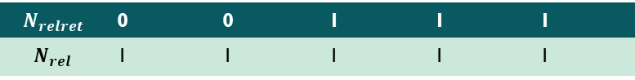
IR System Performance Evaluation Query 1
Query 1: Dress AND Winter AND NOT Vintage
Doc # | 1 | 2 | 3 | 4 | 5
Relevance | - | - | X | - | -
$$N_{relret}$$ | 0 | 0 | 1 | 1 | 1
$$N_{rel}$$ | 1 | 1 | 1 | 1 | 1

Slide 27
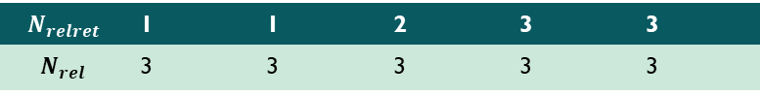
IR System Performance Evaluation Query 1
Query 2: Woman AND Summer AND (Dress OR Skirt)
Doc # | 1 | 2 | 3 | 4 | 5
Relevance | X | - | X | X | -
$$N_{relret}$$ | 1 | 1 | 2 | 3 | 3
$$N_{rel}$$ | 3 | 3 | 3 | 3 | 3

Slide 28
IR System Performance Evaluation - Overall
AvgPrecision and AvgRecall computed as the mean over some sample queries

Slide 29
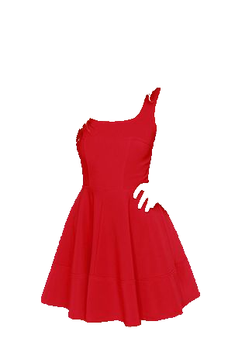
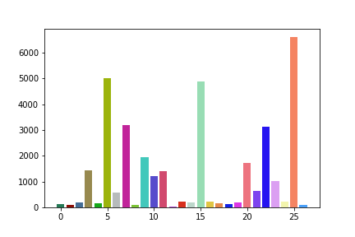
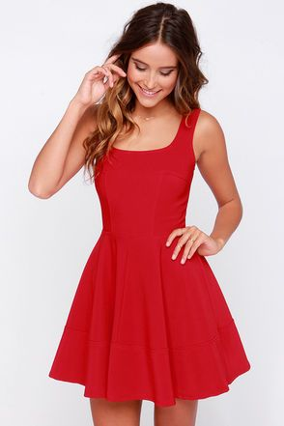
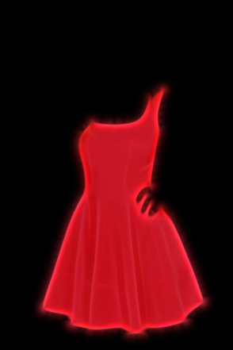
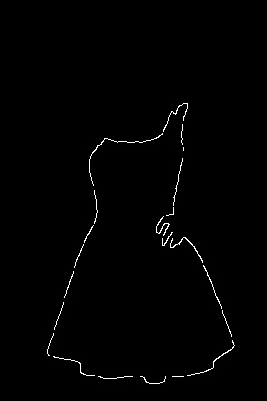
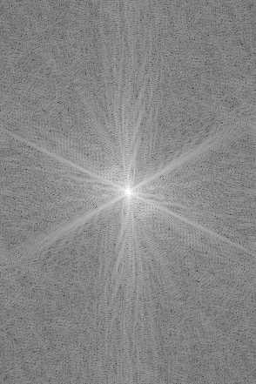
Exercise 1.D – Low Level Features – (Clothes) Global features
Feature and Comparison modality
Color
Quadratic distance, in order to better handle color variation (Bhattacharyya distance better than QBIC QF)
Cloths extractor: segmentation (Haar wavelet + K-means) + NN classification (or SVM) engine
32-D HSV histogram
Texture
Manahattan distance
Because the focus is on clothes, I’m not interested in global feature of the whole picture. Indeed they could be misleading. I would rather use context to extract taxonomy tags, like kind of sport.
60-D Gabor Filter
Shape
DTW (Dynamic Time Warping) distance
First D coefficients of DFT

Slide 30
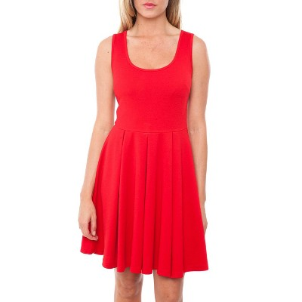
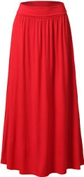
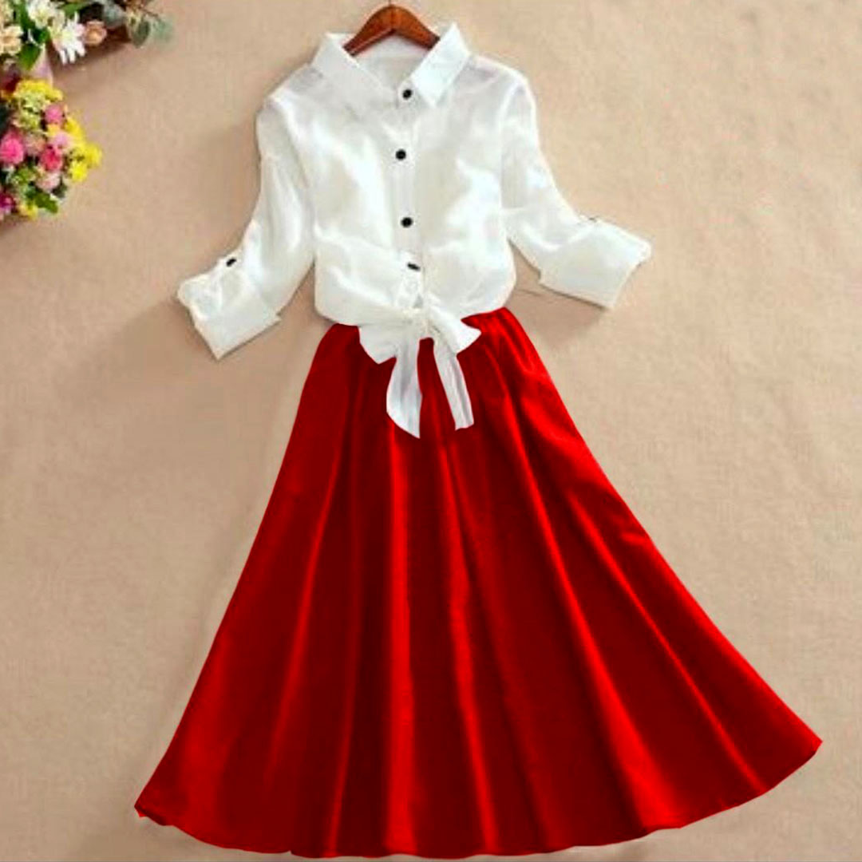
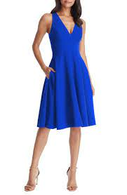
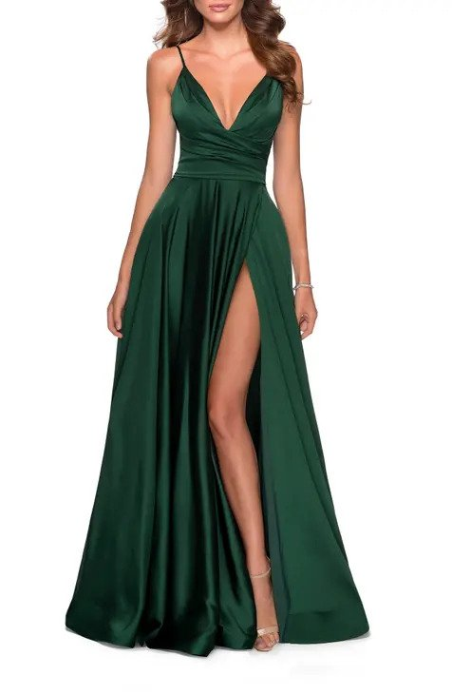
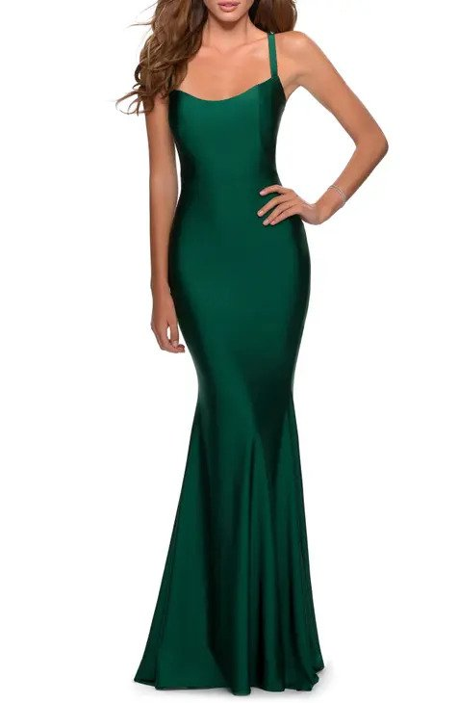
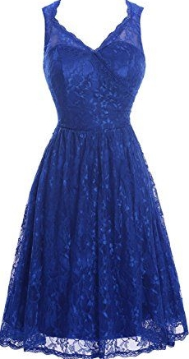
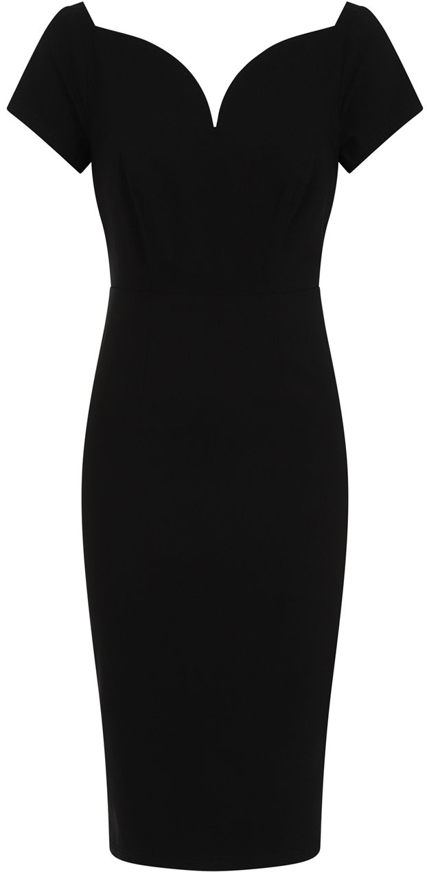
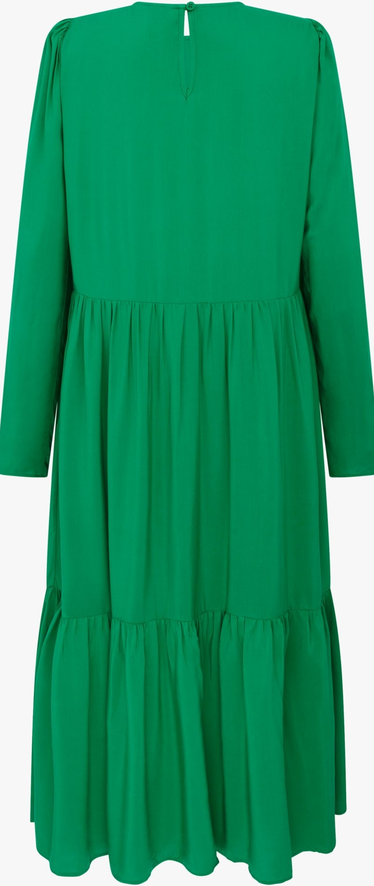
Global features – HSV Bhattacharyya distance ranking
d=0.5465
d=0.5895
d=0.7231
d=0.7957
Query image
d=0.8234
d=0.8243
d=0.8705
d=0.8977
d=0.9435

Slide 31
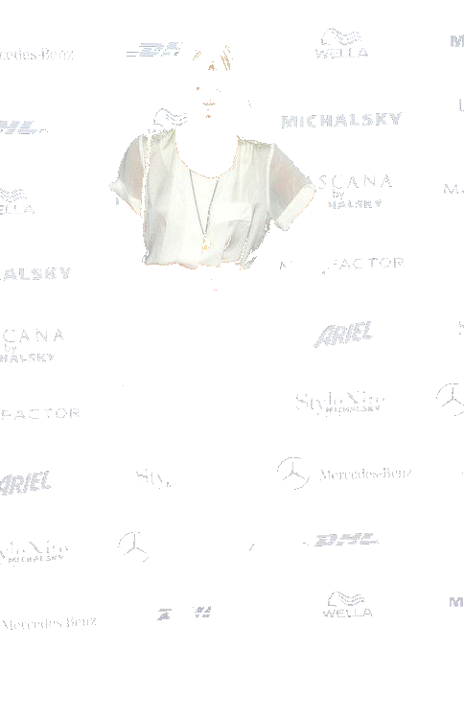
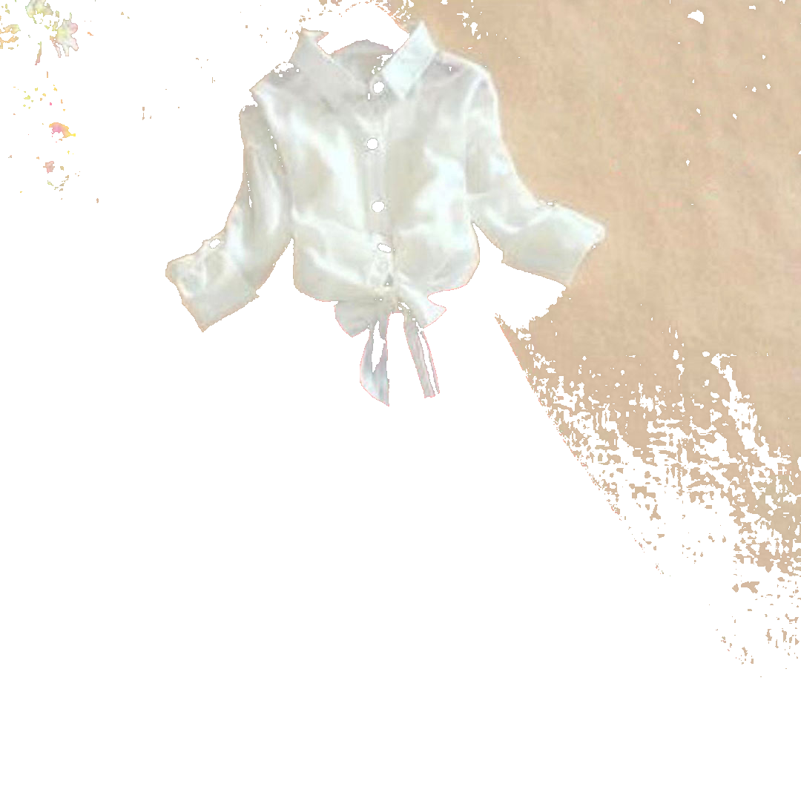
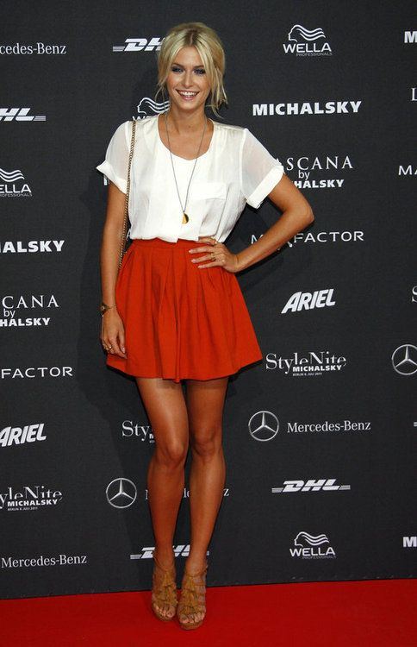
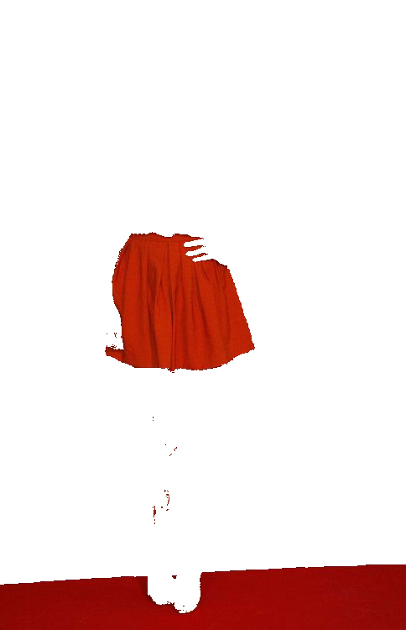
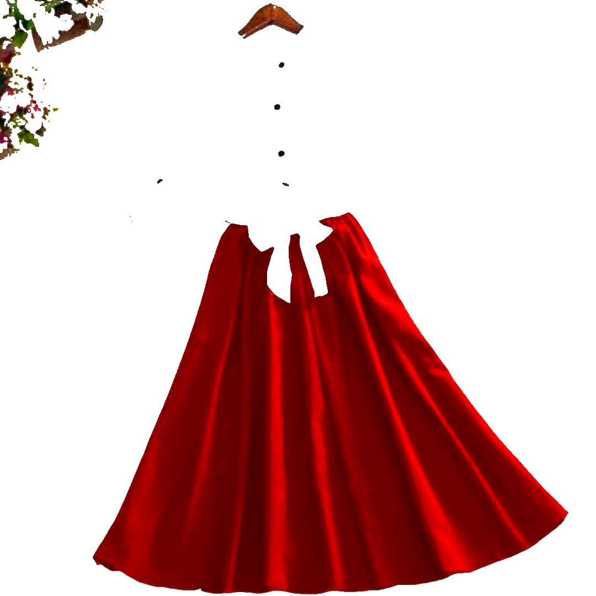
Low Level Features – Local features – Regions’ tags*
Query image
DB image
White shirt**
Use non-clothes regions to assign context tags to clothes (ex. snow for skiwear)
Red skirt
* Similar to IMAGINATION [BC08a]
** Possible enhancement by classifying bg w.r.t. object and mask by colour

Slide 32
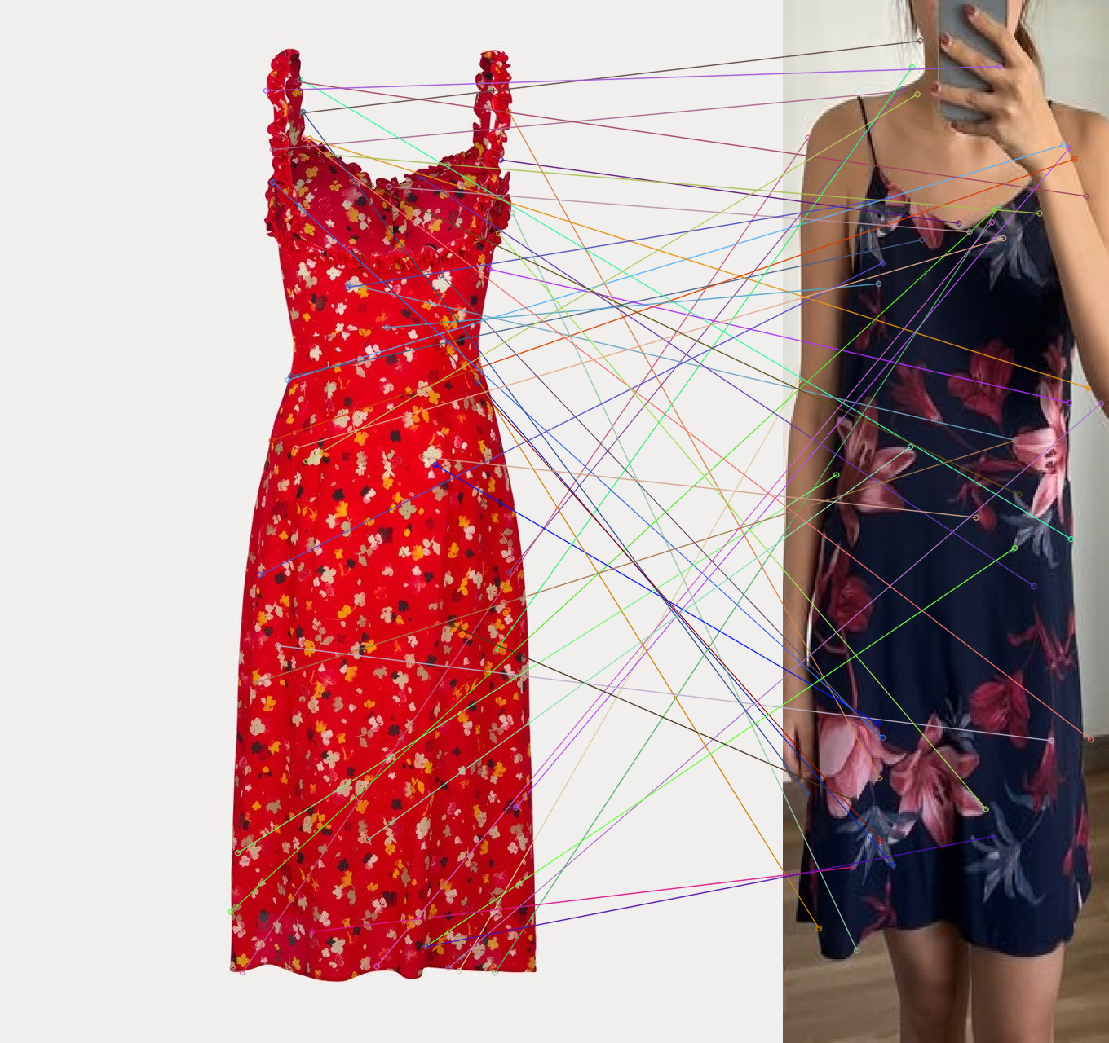
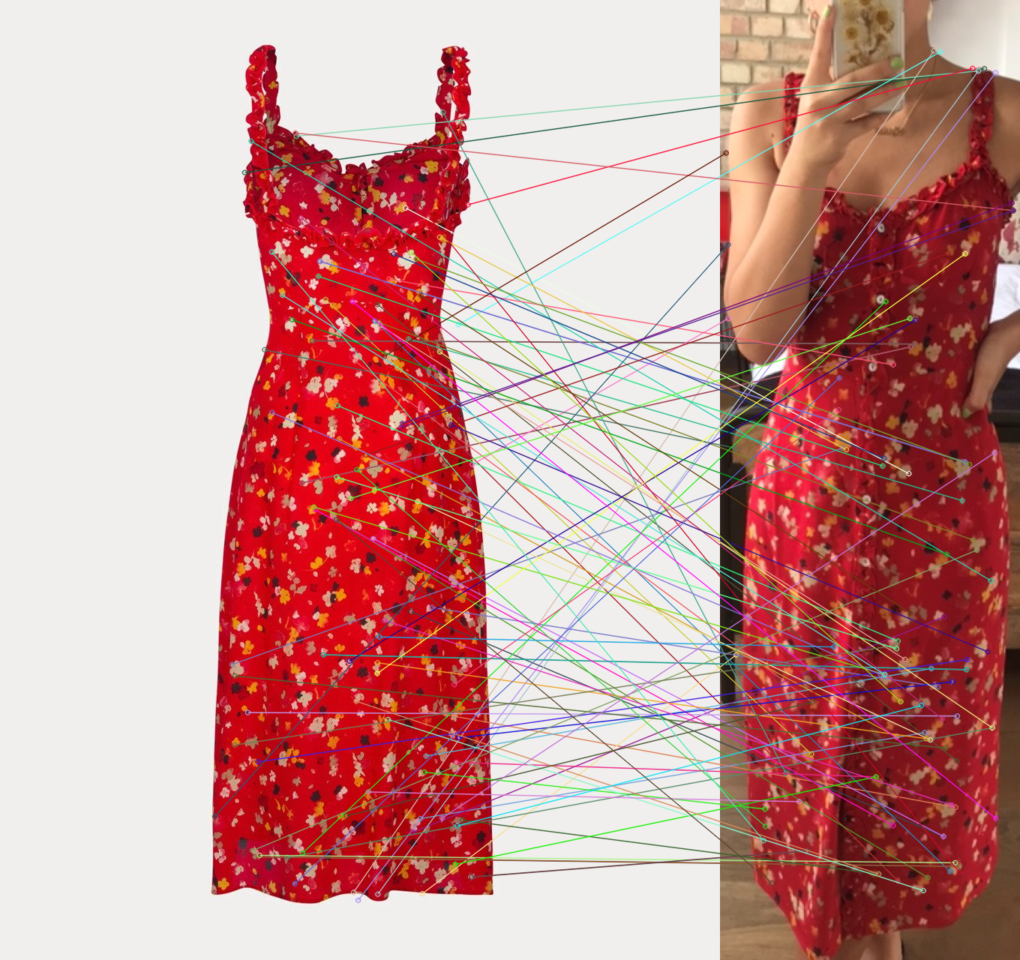
Low Level Features – Local features – SIFT (on Regions)
350 matches (mostly on shape contour)
726 matches

Slide 33


Thank you
Lorenzo Cellini
Lorenzo.cellini3@studio.unibo.it

